Slide 1
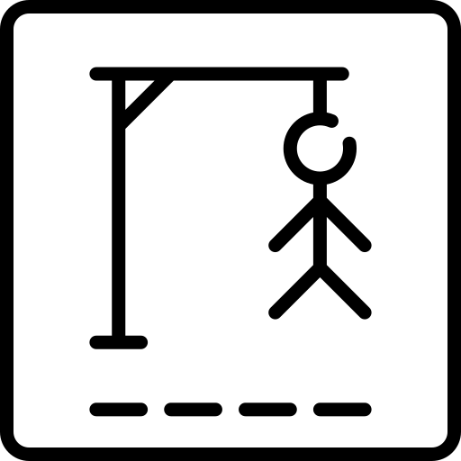
Hangman Game in C
By: Sebastian Gonzalez

Slide 2
Problem Overview
Problem Description:
Hangman is a word-guessing game where a player must guess the letters of a hidden word within a limited number of attempts.
Player 1 chooses a word (the goal word), and Player 2 guesses letters.
The game displays the word with underscores (_) for unguessed letters and updates the display after each guess.
Objective:
Implement a simple C-based version of the Hangman game that tracks guesses, checks for wins or losses, and provides feedback to the user.

Slide 3
Solution Approach
Game Flow
Player 1 provides the goal word (e.g., "apple").
Player 2 guesses a letter one by one.
The program updates the display of the word using underscores and correct guesses.
The game ends if Player 2 either guesses the word or runs out of lives (maximum of 6 incorrect guesses).
Key Features:
Tracks and validates user guesses to prevent repeats.
Displays the current state of the word with updated letters.
Displays feedback on correct or incorrect guesses.
Ends when the word is guessed or Player 2 loses all lives.

Slide 4
Key Functions Overview
Main Functions:
main(): Main game loop controlling the flow (handling input, validating guesses, checking win conditions).
get_guess(): Collects and validates a guess from Player 2.
val_guess(): Checks if the guessed letter has already been guessed.
draw(): Displays the hangman figure based on the number of incorrect guesses.
update_usrword(): Updates the user’s word display based on correct guesses.

Slide 5
Challenges and Solutions
Challenge 1: Preventing repeated guesses.
Solution: The val_guess() function checks the guesses array before accepting a new guess.
Challenge 2: Handling input properly (e.g., avoiding empty or non-character input).
Solution: The get_guess() function handles input validation to ensure only valid guesses are accepted.

Slide 6
Future Improvements
Enhance the draw() function to show a more detailed hangman image.
Have a simple play again and quit option so the program doesn’t have to be rerun every time.
Add an option for Player 1 to choose a category or theme for words (e.g., animals, countries).

